Slide 1
48024 Applications Programming
Dr Angela Huo

Slide 2
Quiz
The output of the program will be: A: S1 equals S2
class StringTest1 B: S1 doesn’t equals S2
{
public static void main(String[] args)
{
String s1="hello";
String s2=new String("hello");
if(s1.equals(s2)){
System.out.println(“S1 equals S2");
}else{
System.out.println(“S1 doesn’t equals S2");
}
}
}

Slide 3
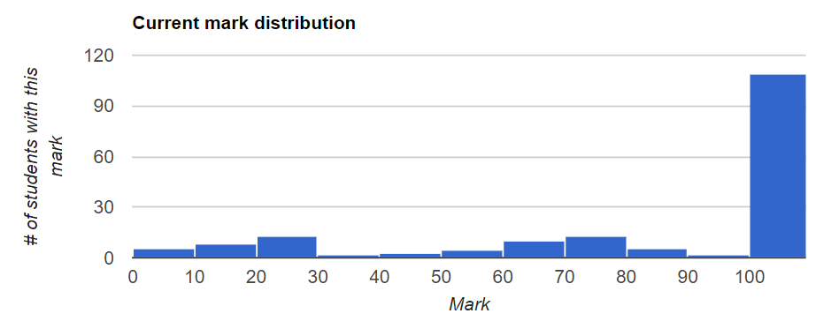
Lab 6 Review

Slide 4
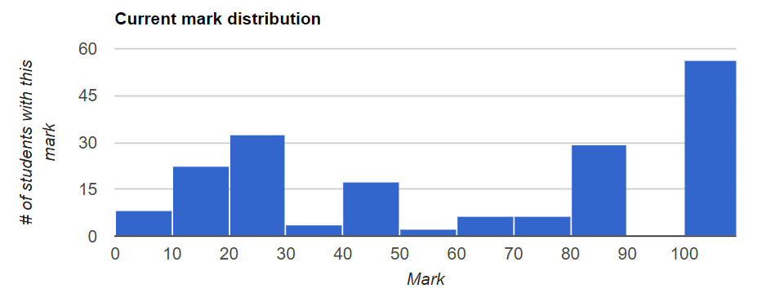
Assignment 1

Slide 5
Inheritance
Overriding(Method) ---Constructor
Hiding(Field) --- TypeConversion
Polymorphism

Slide 6
Interfaces
Abstract Class and Abstract Methods
Abstract Class can’t be instantialized
Abstract methods can’t have body
Inherit an interface
interface A extends B{…}
Field: instance name as prefix
Method: error occurs if only the return values are different

Slide 7
Interfaces & Inheritance
Inheritance
Extends
extends one father
Field, methods
Super/this
Interfaces
Implements
Implements lots of interfaces
Global consts, Abstract method
Must implement abstract methods

Slide 8
Anonymous and Inner Class
An interface cannot be instantiated since it has no implementation:
✖new ProductObserver()
However, you can provide the implementation while instantiating it:
✔
new ProductObserver() {
@Override public void handleSale(double money) { System.out.println(“You paid $” + money);
}
}
Same as defining a class that implements the interface, then creating a new instance of that class.
Except the class has no name. Hence, it is “anonymous”.

Slide 9
Lab 8
15-25min intro/demo
Coding - remaining time
Topics: GUIs and events
anonymous inner classes
For the question on anonymous inner classes, you can ask a followup question: “Why are they called anonymous?” and another: “Why are they called inner?”

Slide 10
The difficulty of the coming weeks
Week 9 introduce MVC
Assignment 2 released
Other assignments due at the same time…..
Time management is very important!

Slide 11

Contact
Subject Coordinator and Lecturer: Angela Huo
Email: huan.huo@uts.edu.au
Contact information on UTSOnline

